Slide 1
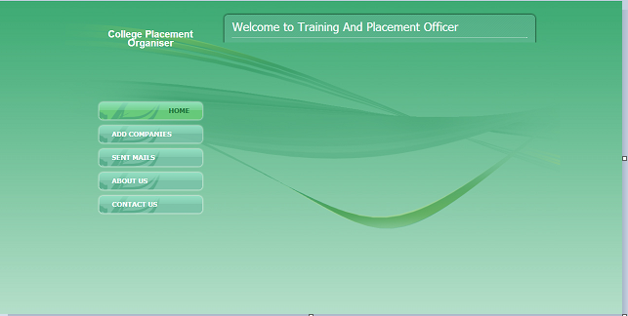
OUTPUT SCREENS HOME PAGE Admin Home Page:

Slide 2
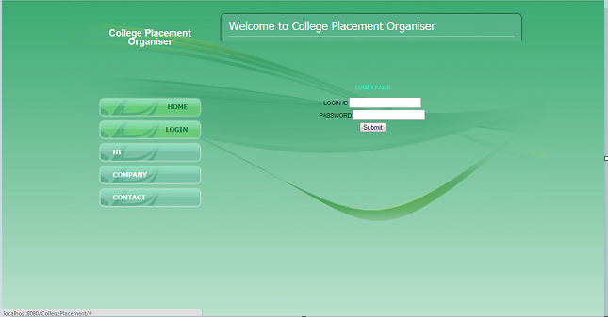
Login Page:

Slide 3
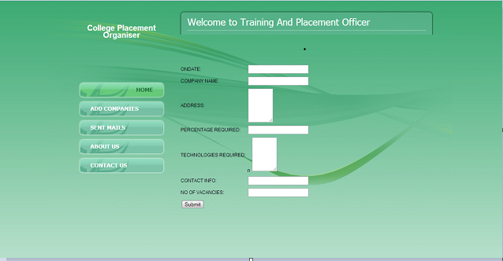
Add companies Page:

Slide 4
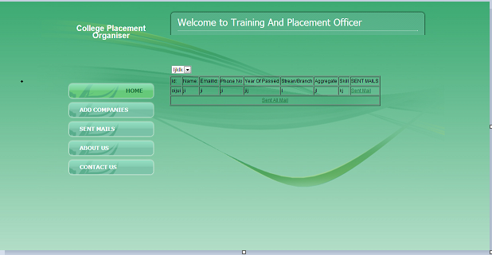
Sending Mails Page:

